Slide 1
Molecules, Moles & Chemical Equations
Chapter 3

Slide 2
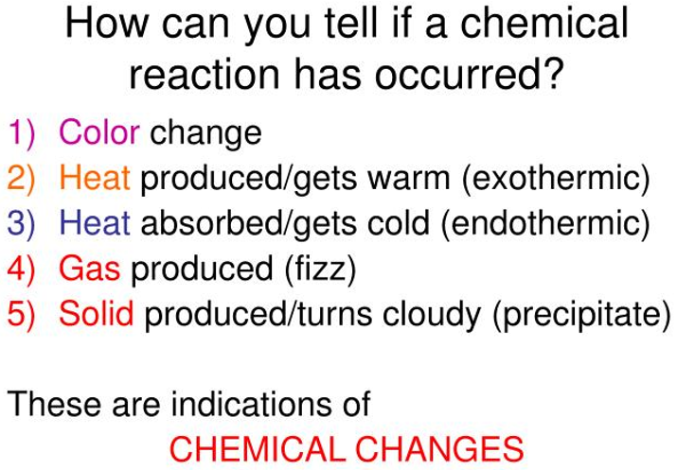
Chemical reaction
Chemical reaction is a process in which a substance is changed into one or more new substances.
Chemical equation uses chemical symbols to show what happens during a chemical reaction.

Slide 3
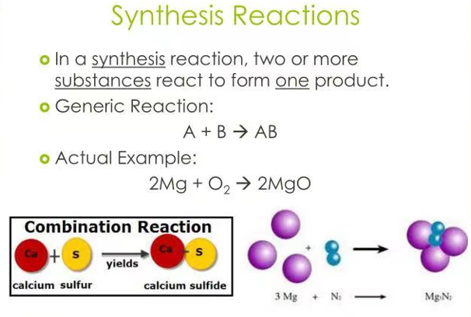
Types of chemical reactions

Slide 4
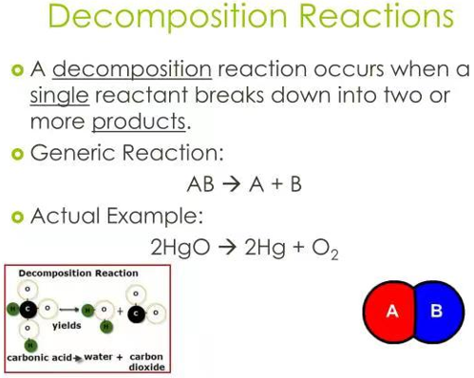
Types of chemical reactions

Slide 5
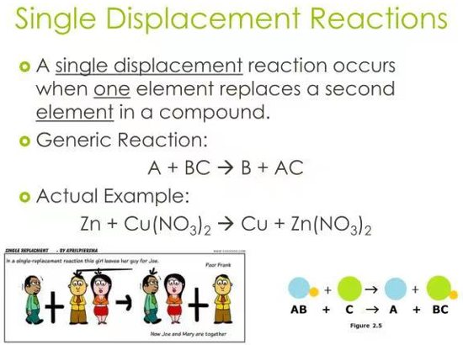
Types of chemical reactions

Slide 6
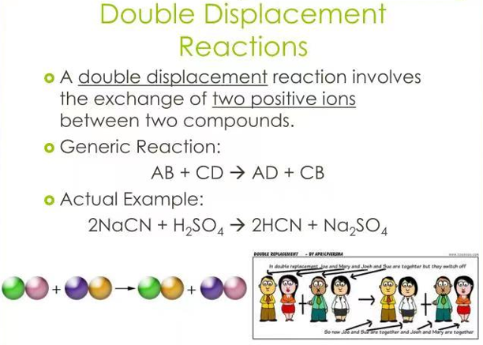
Types of chemical reactions

Slide 7
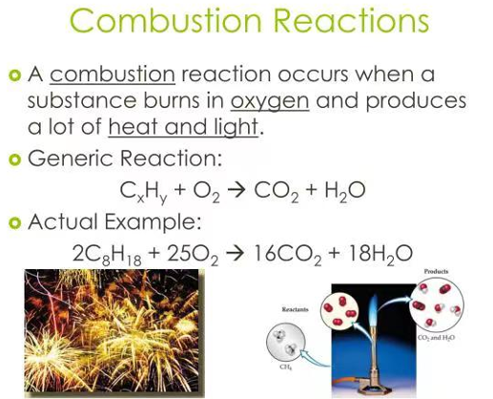
Types of chemical reactions

Slide 8
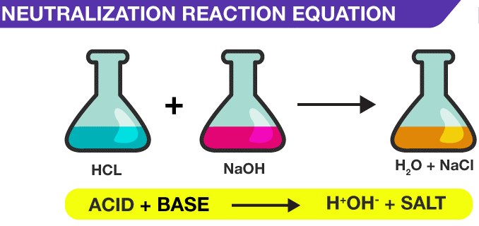
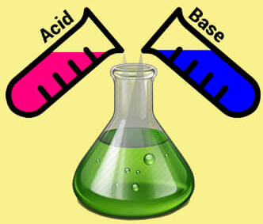
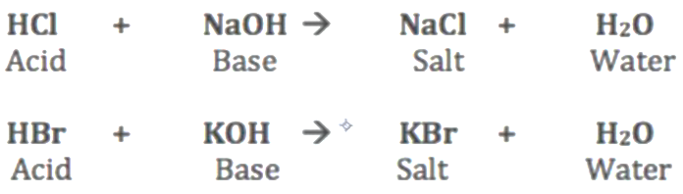

Slide 9
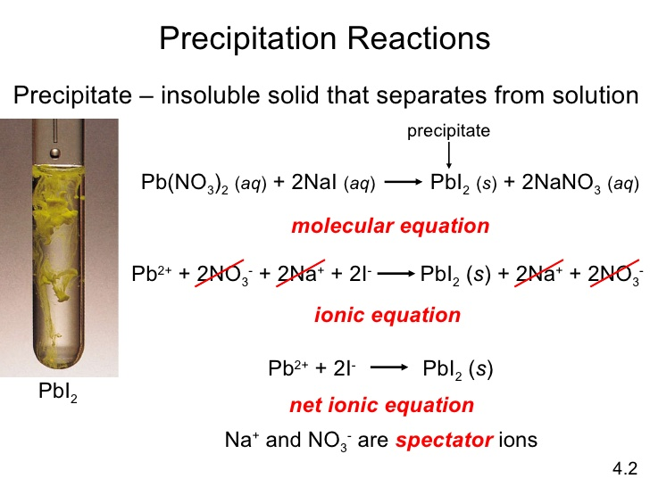
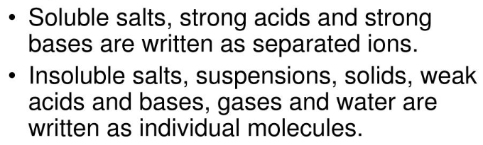

Slide 10
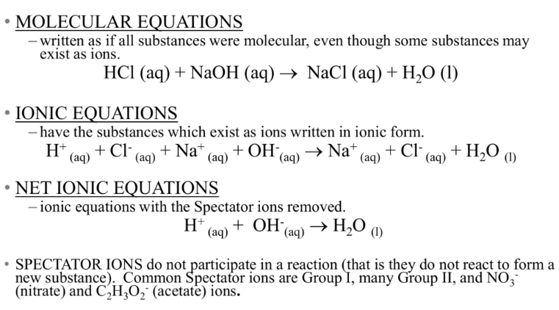
It shows the complete formula of each compound involved.

Slide 11
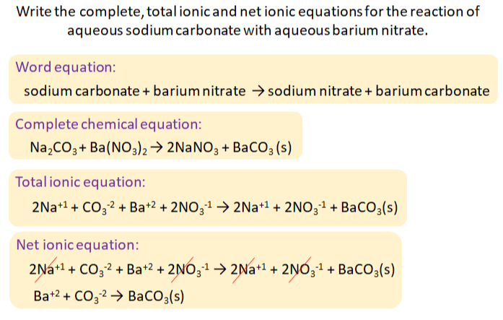
Ionic equation

Slide 12
Practice exercise
Write the total ionic equation and net ionic equation of the following.

Slide 13
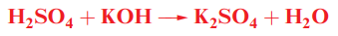
Practice exercise: Types of chemical reactions

Slide 14
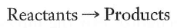
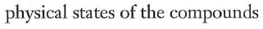
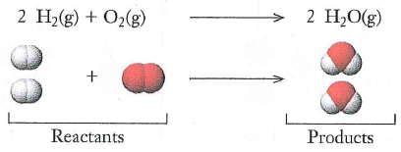
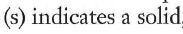
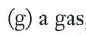
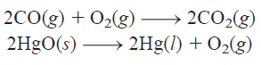
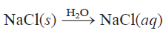
Chemical Equations

Slide 15
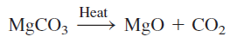
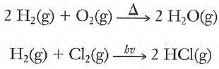
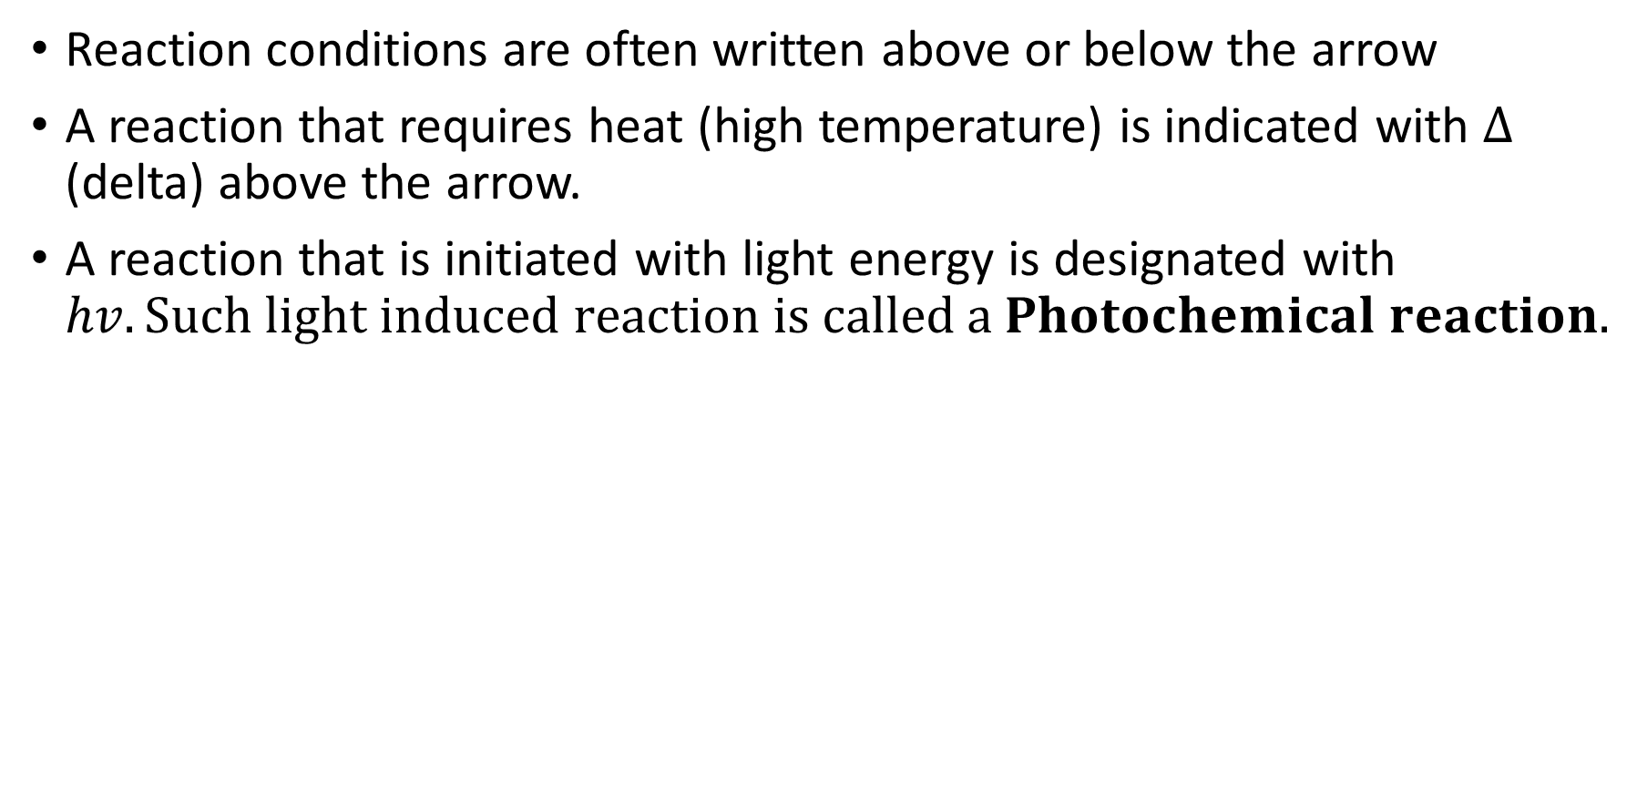
Reaction conditions are often written above or below the arrow
A reaction that requires heat (high temperature) is indicated with $∆$ (delta) above the arrow.
A reaction that is initiated with light energy is designated with $hv. Such light induced reaction is called a Photochemical reaction.$

Slide 16
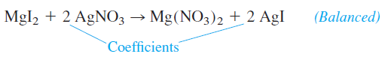
Balancing Chemical Equations
Coefficients—numbers that are written before the formulas.
The coefficient multiplies everything in the formula:

Slide 17
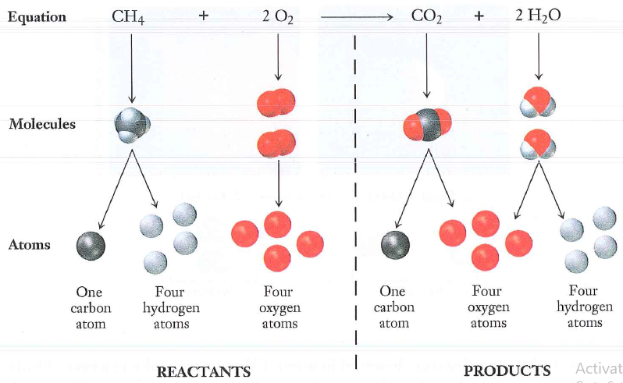
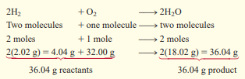
Balancing Chemical Equations
Law of Conservation of matter
Matter is neither created nor destroyed.
Atoms of one element are neither created nor destroyed in a chemical reaction.
Hence, there must same number of atoms on both sides of the equation.

Slide 18
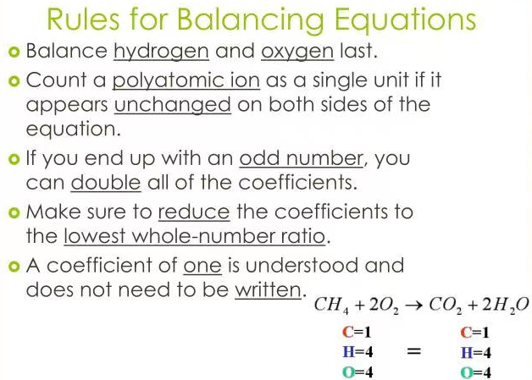
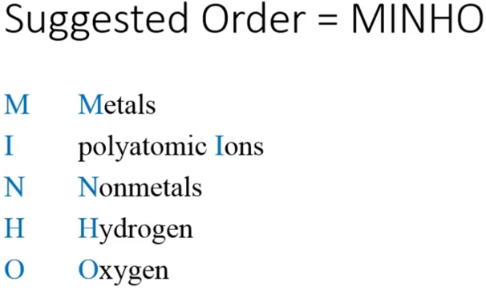
Balancing Chemical Equations

Slide 19
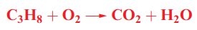
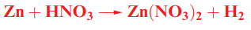
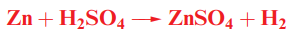
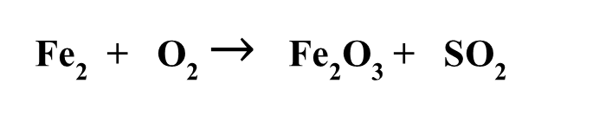
Practice exercise
Fe₂ + O₂ $→$ Fe₂O₃ + SO₂

Slide 20
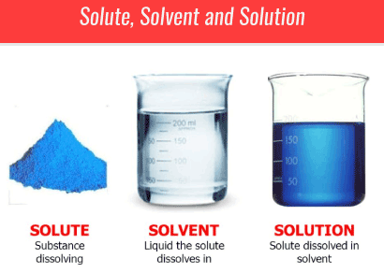
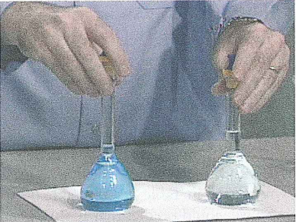
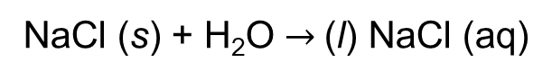
Aqueous solution
Concentrated solution: Higher solute particles
Dilute solution: Few solute particles
NaCl (s) + H₂O $→$(l) NaCl (aq)

Slide 21
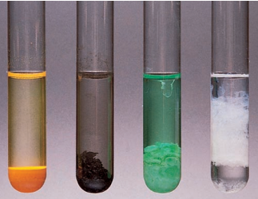
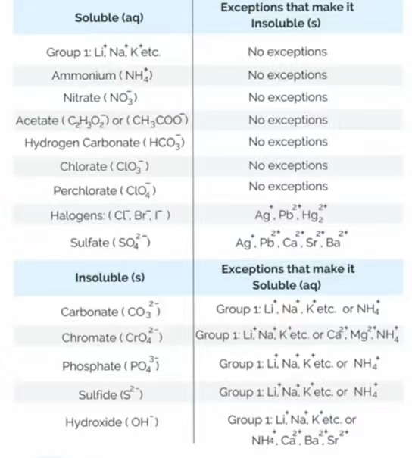
Solubility
Appearance of precipitates
‘The maximum amount of a solute that can be dissolved in a solvent under given physical conditions (temperature, pH, etc.)’.
The higher the solubility of a compound, the larger the amount of the compound that can dissolve in a solution.
Less soluble compounds tend to precipitate from water

Slide 22
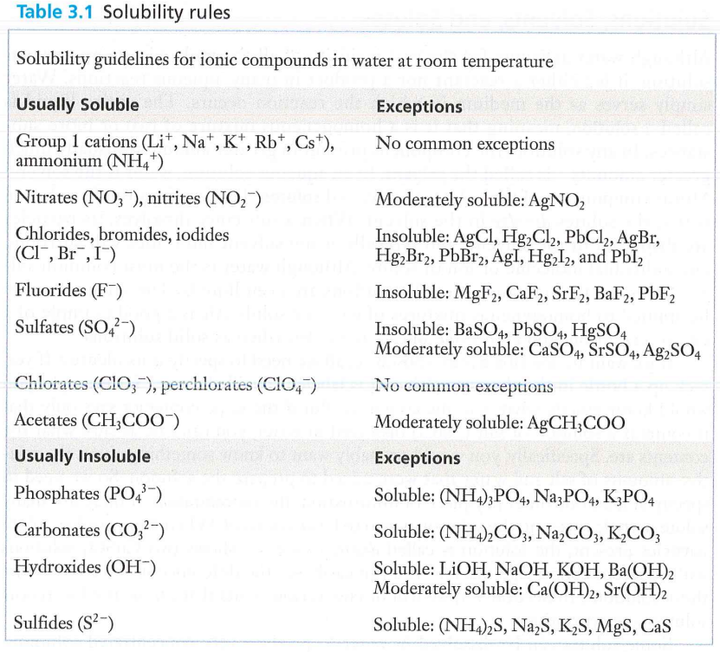

Slide 23
Practice exercise solubility
KBr AgCl
PbI NaNO₃
Li₂S (NH₄)₃PO₄
Mn(OH)₂ MgCO₃
Ba(OH)₂ Li₂CO₃
PbSO₄ KOH
AgNO₃ K₂SO₄
CaS (NH₄)₂CrO₄
Mg₃(PO₄)₂ Pb(NO₃)₂
(aq)
(s)
(s)
(aq)
(aq)
(aq)
KBr
(s)
(s)
(aq)
(aq)
(s)
(aq)
(aq)
(aq)
(s)
(aq)
(s)
(aq)

Slide 24
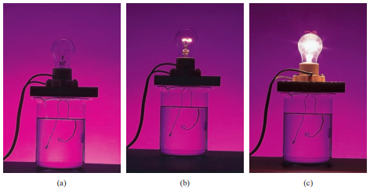
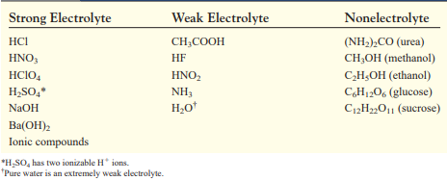
Electrolytes & Nonelectrolytes
All solutes that dissolve in water ﬁt into one of two categories: electrolytes and nonelectrolytes.
An electrolyte is a substance that, when dissolved in water, results in a solution that can conduct electricity.
A nonelectrolyte does not conduct electricity when dissolved in water.
Nonelectrolyte solution
Weak electrolyte solution
Strong electrolyte solution

Slide 25
The Mole and Avogadro’s number
The “Mole” The term mole was introduced about 1895 by Wilhelm Ostwald (1853–1932).
Latin word moles, meaning a “heap” or a “pile.”
Mole is a number, like a dozen, except very much larger
The mole is the standard chemical unit used to measure the quantity of a substance.
A mole is the amount of a substance that contains as many elementary entities (atoms, molecules, or other particles) as there are atoms in exactly 12 g of the C-12 isotope.
One mole always contains the same number of particles, no matter what the substance.
This value is known as Avogadro’s number (symbolized by NA).
Amedeo Avogadro, an Italian physicist (1776–1856) conceived the basic idea
1 mole Na contains the same number of atoms as 1mole Fe and the same as number of molecules in 1 mole H₂O.

Slide 26
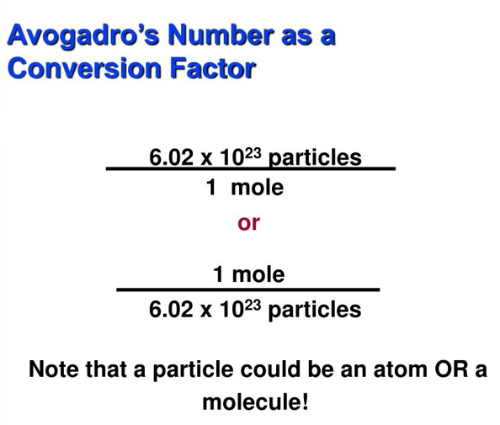
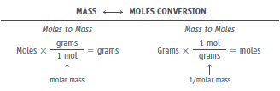
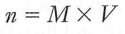
Calculate the number of moles of H atoms in 6.170 mol of H₂O.

Slide 27
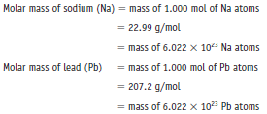
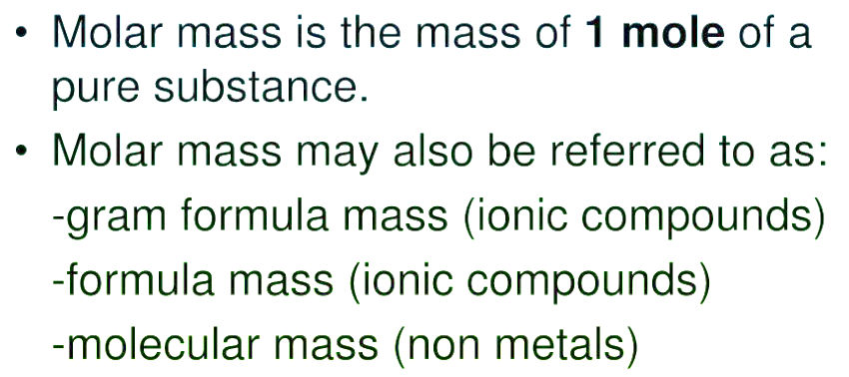
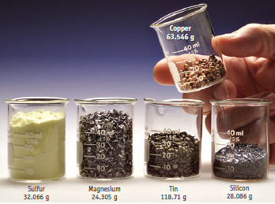
Atoms and Molar Mass
An element’s molar mass is the amount in grams numerically equal to its atomic weight.
One mole of common elements

Slide 28
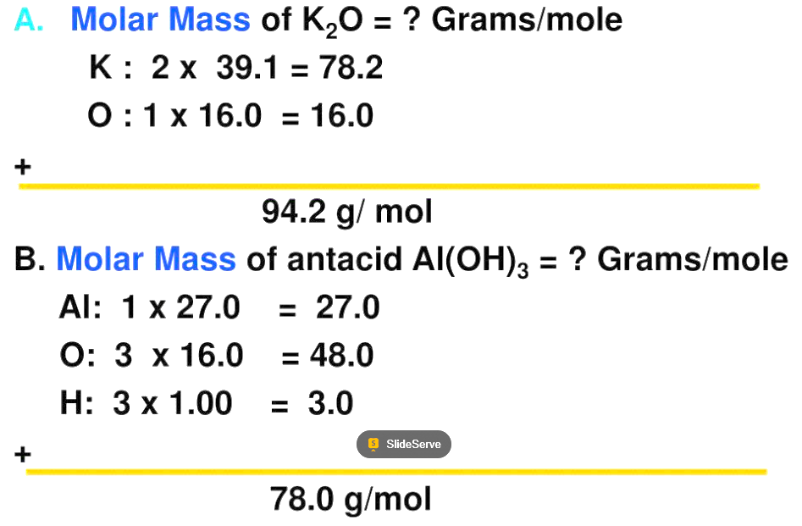
Molar Mass
Xylaric acid, C₅H₈O₇
Diphenolic acid, C₄H₇(C₆H₅O)₂COOH

Slide 29
Empirical & molecular formulas
The empirical formula of a compound is the simplest possible formula (with integer subscripts) that gives the composition of the compound.
The molecular formula of a compound is the formula consistent with the relative molecular mass.
In a chemical formula, the subscripts represent the ratio of the number of moles of each element that combine to form one mole of the compound.

Slide 30
Determining empirical formulas
A compound contains 1.71g C and 0.287g H. What is its empirical formula?
Rule:
Find molar masses of each element.
Divide each subscript by the smallest subscript
Multiply each subscript by 2 (if its still not a whole number)
Determine the empirical formula of a compound that has a percent composition of 43.7% P and 56.3% O.
Rules:
change the % signs to grams.
convert the numbers of grams to moles
A compound contains 5.31g Cl & 8.40g O. What is its empirical formula?

Slide 31
Practice exercise
Combustion of 11.5 g of ethanol produces 22.0 g of CO₂ and 13.5 g of H₂O. Calculate the mass of carbon and hydrogen in the original 11.5-g sample of ethanol. Calculate the empirical formula of ethanol?
Ascorbic acid is composed of 40.92% C, 4.58% H, & 54.50% O by mass. Determine its empirical formula.

Slide 32
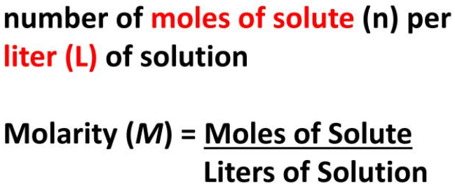
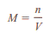

Molarity
Mole,
Preparing a solution of known molarity.
A known amount of a solute is transferred into the volumetric ﬂask; then water is added through a funnel.
The solid is slowly dissolved by gently swirling the ﬂask.
More water is added to bring the level of solution to the mark.
Knowing the volume of the solution and the amount of solute dissolved in it, we can calculate the molarity of the prepared solution.

Slide 33





Practice exercise
Q. What is the molarity (M) of a 400 mL solution having 8 g NaOH?
Q. What is the molarity (M) of the solution if 3 mole of solute is dissolved in 12 L solution?

Slide 34



Practice exercise
How many grams of potassium dichromate (K₂Cr₂O₇) are required to prepare a 250-mL solution whose concentration is 2.16 M?
A chemist needs to add 3.81 g of glucose to a reaction mixture. Calculate the volume in mL of a 2.53 M glucose solution.
3.81 g C6H12O6 × $\frac{\text{1 }\text{mol} \text{C}\text{6}\text{H}\text{12}\text{O}\text{6}}{\text{180.2 }\text{g} \text{C}\text{6}\text{H}\text{12}\text{O}\text{6 } }$
= 2.114 × 10⁻² mol C6H12O6
= $\frac{\text{2.114 }\text{×} \text{10}\text{-2 } \text{mol} \text{C}\text{6}\text{H}\text{12}\text{O}\text{6}}{\text{2.53 }\text{mol} \text{C}\text{6}\text{H}\text{12}\text{O}\text{6}\text{/}\text{L} \text{soln}}$ × $\frac{\text{1000 }\text{mL} \text{soln}}{1 L solution}$
= 8.36 mL soln

Slide 35




Dilution of solutions
Dilution is the procedure for preparing a less concentrated solution from a more concentrated one.
In dilution process, adding more solvent to the stock solution changes (decreases) the concentration of the solution without changing the number of moles of solute
Fig. The dilution of a more concentrated solution ‘does not change the total number of solute particles’
Mi & Mf = initial and ﬁnal molar concentrations of the solution
Vi & Vf = initial and ﬁnal volumes of the solution
Mi > Mf
Vf > Vi

Slide 36



Practice Exercise
Describe how you would prepare 5.00 $×$ 10² mL of a 1.75M H₂SO₄ solution, starting with 8.61M stock solution of H₂SO₄.
How would you prepare 2.00 $×$ 10² mL of a 0.866 M NaOH solution, starting with a 5.07 M stock solution?
Mi = 8.61 M Mf = 1.75 M
Vi = ? Vf = 5.00 $×$ 10² mL
V_{i} =
102 mL
Check The initial volume is less than the ﬁnal volume, so the answer is reasonable.

